Slide 1
The Writing Process
Step 1: Prewriting

Slide 2
What Is an Academic Essay?
The purpose of the academic essay is to communicate your researched and objective views of a topic to a specific audience. It has the following features:
  A group of paragraphs organized into three sections: the introduction, the body, and the conclusion
  A thesis statement that communicates the writer’s message to a specified audience
  Formal, academic style
  Third-Person, Objective Point-of-View (POV)
  Sound Critical thinking and logic
  Polished final draft reflecting revision, editing, and proofreading
  A balance of rhetoric using the Rhetorical Triangle to conceptualize the relationship of the text, the author, and the audience.

Slide 3
What Is the Writing Process?
Though the steps below are linear, writing is recursive, so you can revisit any of the stages in the process of completing the assignment.
Prewriting: Finding and exploring ideas (can occur at any stage)
Drafting: Putting the essay together
Revision: Reconsidering content of essay draft
Editing: Checking draft for grammar, mechanics, and documentation errors; making sure you have completed all of the assignment requirements
Proofreading: Polish the essay and look for minor/stray errors before submitting the paper by the deadline

Slide 4
Definition and Purpose
Prewriting, also called invention or discovery, generates and explores ideas and fleshes out topics and thoughts without filters.
This step helps clear the author’s brain; allows the author to get down on paper everything he knows about a subject; and enables the author to begin organizing information
Choosing a particular prewriting technique depends on the author and the purpose. Some techniques lend themselves to more detailed information.
Prewriting is helpful at several points in the writing process. For example, you can use it to respond to an assignment, find and then narrow a topic, and identify supporting ideas for a narrowed topic.

Slide 5
Prewriting Types
The most common prewriting techniques are:
  Brainstorming
  Freewriting
  Clustering
  6 Journalism Questions
During prewriting, writers must not worry about grammar, mechanics, spelling, or coherence.
The purpose is to get down as many ideas as possible.

Slide 6
Brainstorming
Brainstorming is also called listing.
Brainstorming involves listing as many ideas as one can in five minutes.
These ideas should be one word or short phrases. You are not paragraphing yet.
The list should provide general and specific ideas. Example:
  General idea: teacher
  Specific ideas: kindergarten teacher; special needs teacher; college professor to undergraduates; teaching a general education required course; teaching at a community college; teaching Sunday school
Brainstorming is best suited to finding ideas rather than discovering what you know about those ideas.

Slide 7
Freewriting
Freewriting is usually done in sentence or paragraph length. Though we are still not worried about presenting revised or edited work, we are wanting to avoid short words or phrases (brainstorming).
It requires non-stop writing for 10-15 minutes. To avoid pausing, if you cannot think of anything to say, you simply write a nonsense phrase, like blah, blah, blah, until your mind resets and thinks of something else on topic.
Though this is hard to do, the reason we write non-stop for at least 10 minutes is to get to the deeper ideas we have on a topic. The first ideas that we write down are usually the common ones that most people would already know. Since an essay is to tell the reader something they don’t know or show what they do know in a different perspective, we want to dig deep into our knowledge.

Slide 8
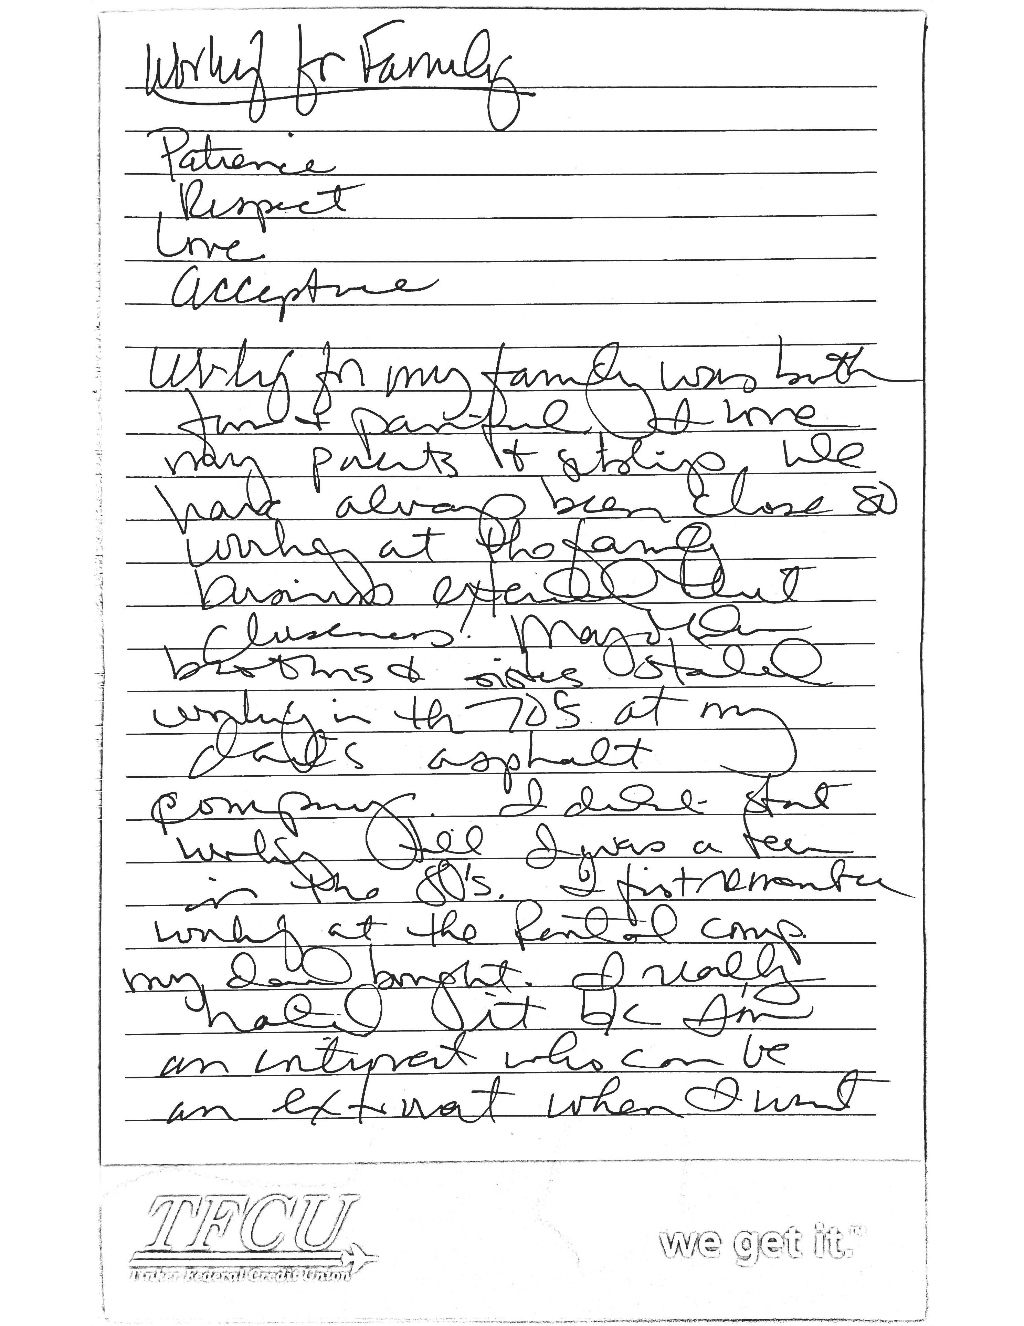
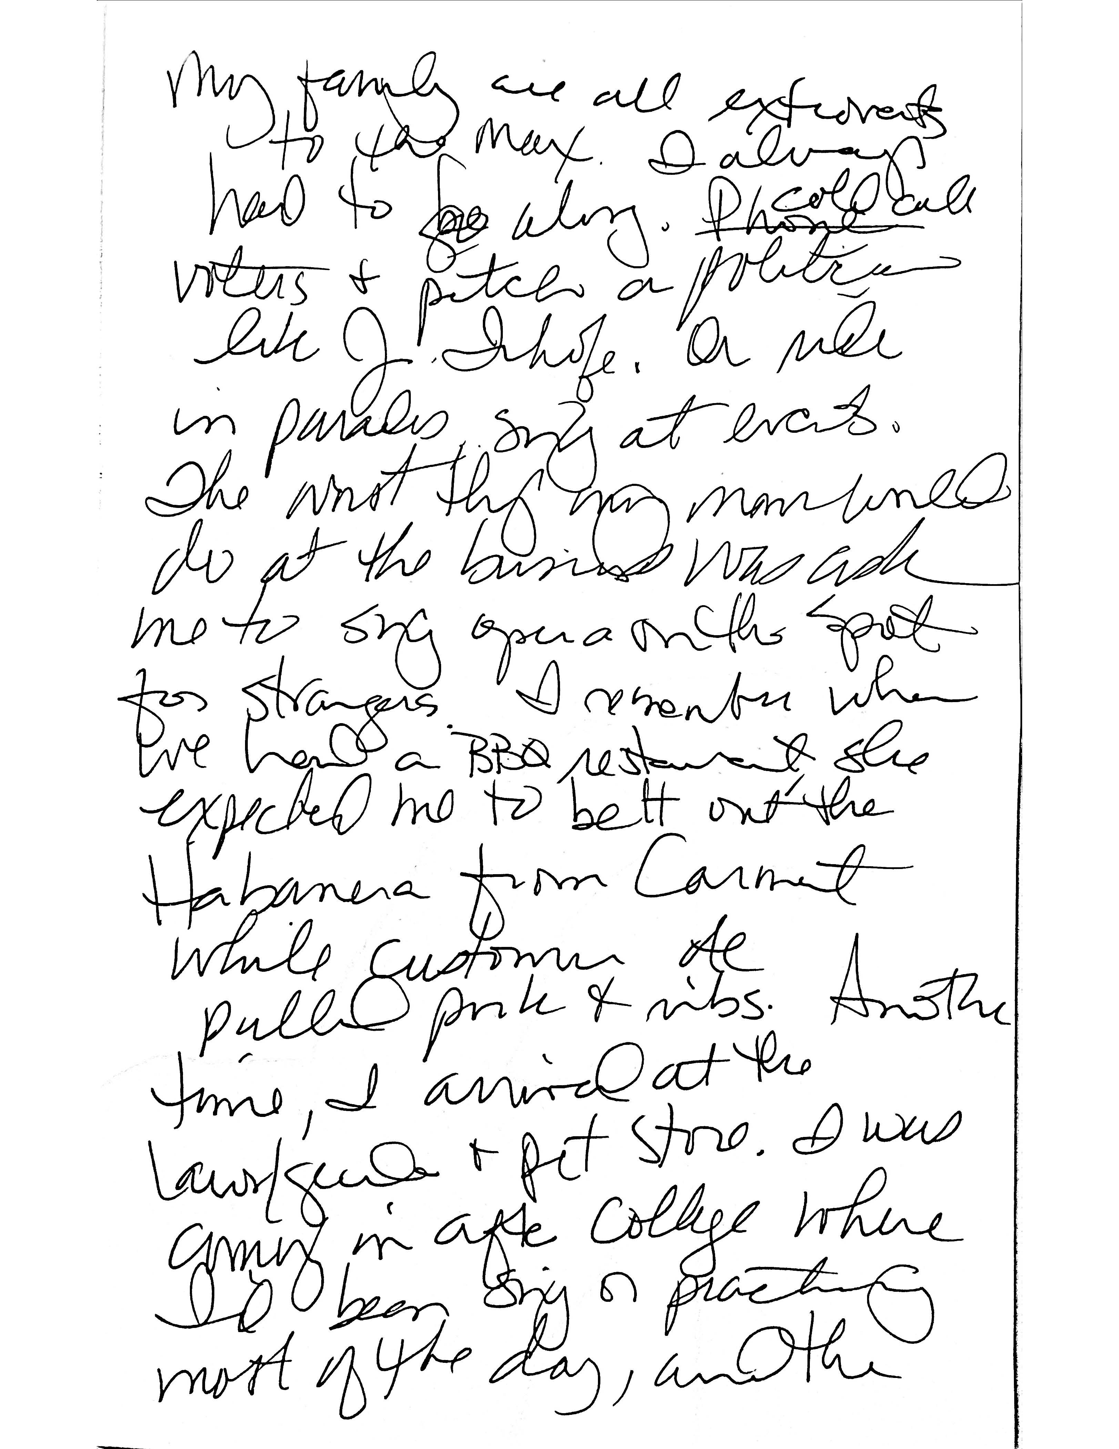
Freewriting Example

Slide 9
Clustering
Also called mapping, clustering is a more spatial form of freewriting.
It establishes a hierarchy of levels to a topic.
  Level 1: Start in the center of a page with the idea or topic you want to prewrite on.
  Level 2: List ideas about the topic.
  Level 3: From each level 2 idea, write ideas about each and arrange them around the specific level 2 idea.
Each level can correspond to a part of the essay:
  Level 1: main idea in the thesis
  Level 2: primary support points (topic sentences)
  Level 3: secondary support points (explanations, examples, data)

Slide 10
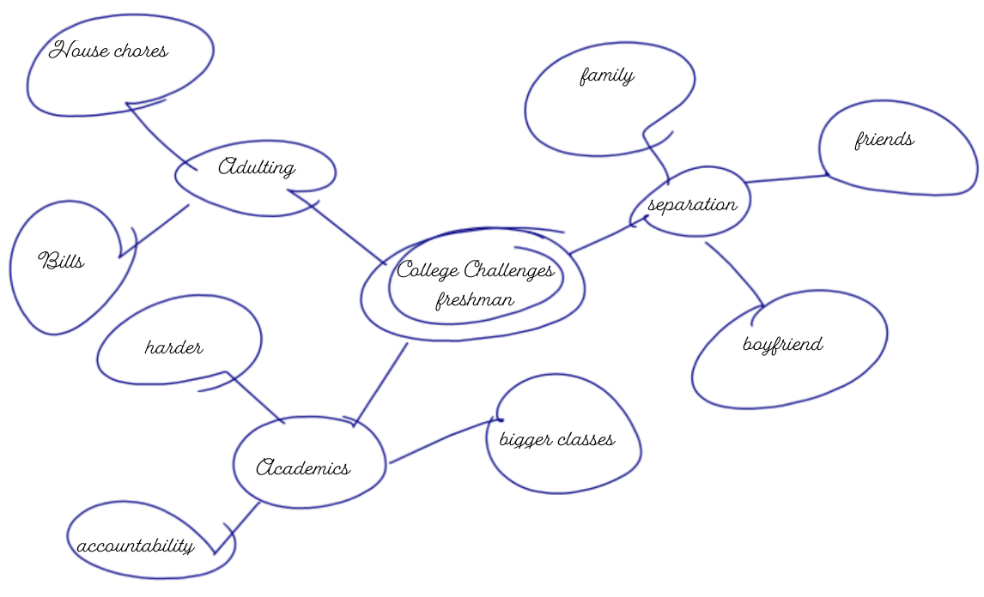
Clustering Example

Slide 11
6 Journalism Questions
Who, What, Where, When, Why, How: We can use these questions to interview a topic.
Helps identify what you do and don’t know and determine possible audiences and purposes.
For each of the 6 questions, think of different ways to ask them:
  Who is responsible? Who benefits? Who would be interested? Who would have more information?
  What is my purpose? What caused this to start? What ended the issue?
  Where did the problem start? Where can I find more information? Where did the money end up?
  When did this start? When did authorities find out? When will this need to finish?
  Why should people care? Why did those in power not stop this? Why did people go along?
  How can this problem be solved? How could people have changed their behavior.

Slide 12
Final Thoughts
Prewriting may seem inconsequential, but it is an important step in helping writers craft their essay.
Skipping this step of the writing process can lead to problems down the line, such as:
  Running out of ideas to write about and realizing that your topic isn’t suited for the assignment.
  Inconsistent focus because you are not sure what you are writing about and have too many ideas floating around.
  Trite or boring ideas because you chose the easiest that came to mind instead of delving deeper into the idea.

